Slide 1






doubleZ
Tongji University
All right reversed.

Slide 2










K
R

Slide 3

Knowledge
Reasoning
张喆 闫雪原
doubleZ
Tongji University
All right reversed.

Slide 4



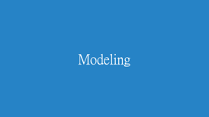
Knowledge
Reasoning

Slide 5
Requirement Engineering

Slide 6

Requirement Engineering
Basic Keywords
Natural language
Painting creation
Mathematical language
The physical model
The chemical formula
……
Knowledge

Slide 7

Requirement Engineering
Basic Keywords
Knowledge Representation
Knowledge
KR

Slide 8
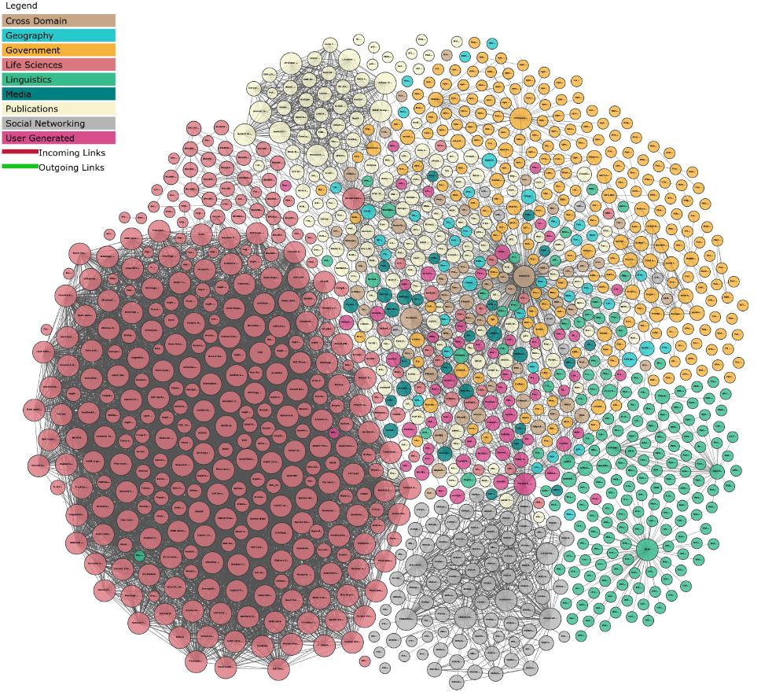
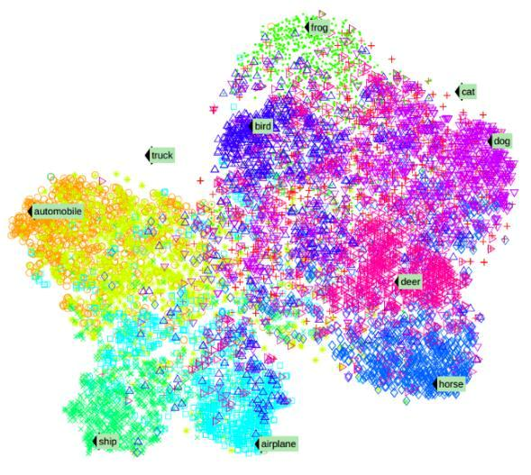
Requirement Engineering
Basic Keywords
Discrete symbols
Knowledge
KR
Continuous vector
Notes:
基于离散符号的知识表示
基于连续向量的知识表示
在保留语义的同时，将知识图谱中的实体和关系映射到连续的稠密的低维向量空间

Slide 9

Requirement Engineering
Basic Keywords
In today's Internet, all kinds of application, thus produced huge amounts of data resource, which contains a large number of valuable knowledge.
How to organize these knowledge, in order to make further calculation and analysis. Much attention has been paid to knowledge graph arises at the historic moment, the entity (including the concept, attribute values) represented as graph nodes, node of the edge between the corresponding relationship between entities, with a network structure characterization of acquired knowledge, clear and intuitive.
Knowledge
KR
KG

Slide 10
Requirement Engineering
Basic Keywords
In today's Internet, all kinds of application, thus produced huge amounts of data resource, which contains a large number of valuable knowledge.
How to organize these knowledge, in order to make further calculation and analysis. Much attention has been paid to knowledge graph arises at the historic moment, the entity (including the concept, attribute values) represented as graph nodes, node of the edge between the corresponding relationship between entities, with a network structure characterization of acquired knowledge, clear and intuitive.
Knowledge
KR
KG

Slide 11

Requirement Engineering
Basic Keywords
Knowledge
KR
KG
Knowledge Reasoning

Slide 12
Requirement Engineering
Lab
Operation and Maintenance
Maintenance of established network hardware and software in large organizations.
However, in the face of massive monitoring data and huge distributed system, all kinds of operation and maintenance subjects have their own characteristics and rules and are interrelated, which increases the difficulty of operation and maintenance decision-making, and operation and maintenance knowledge graph emerges at the right moment.
Notes:
运维
对大型组织已经建立好的网络软硬件的维护

Slide 13
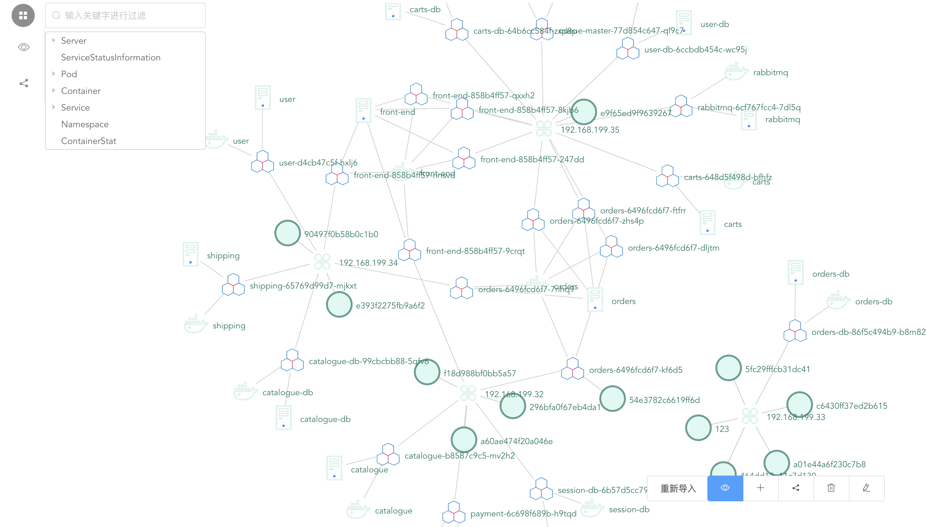
Requirement Engineering
Lab
Notes:
运维
对大型组织已经建立好的网络软硬件的维护

Slide 14
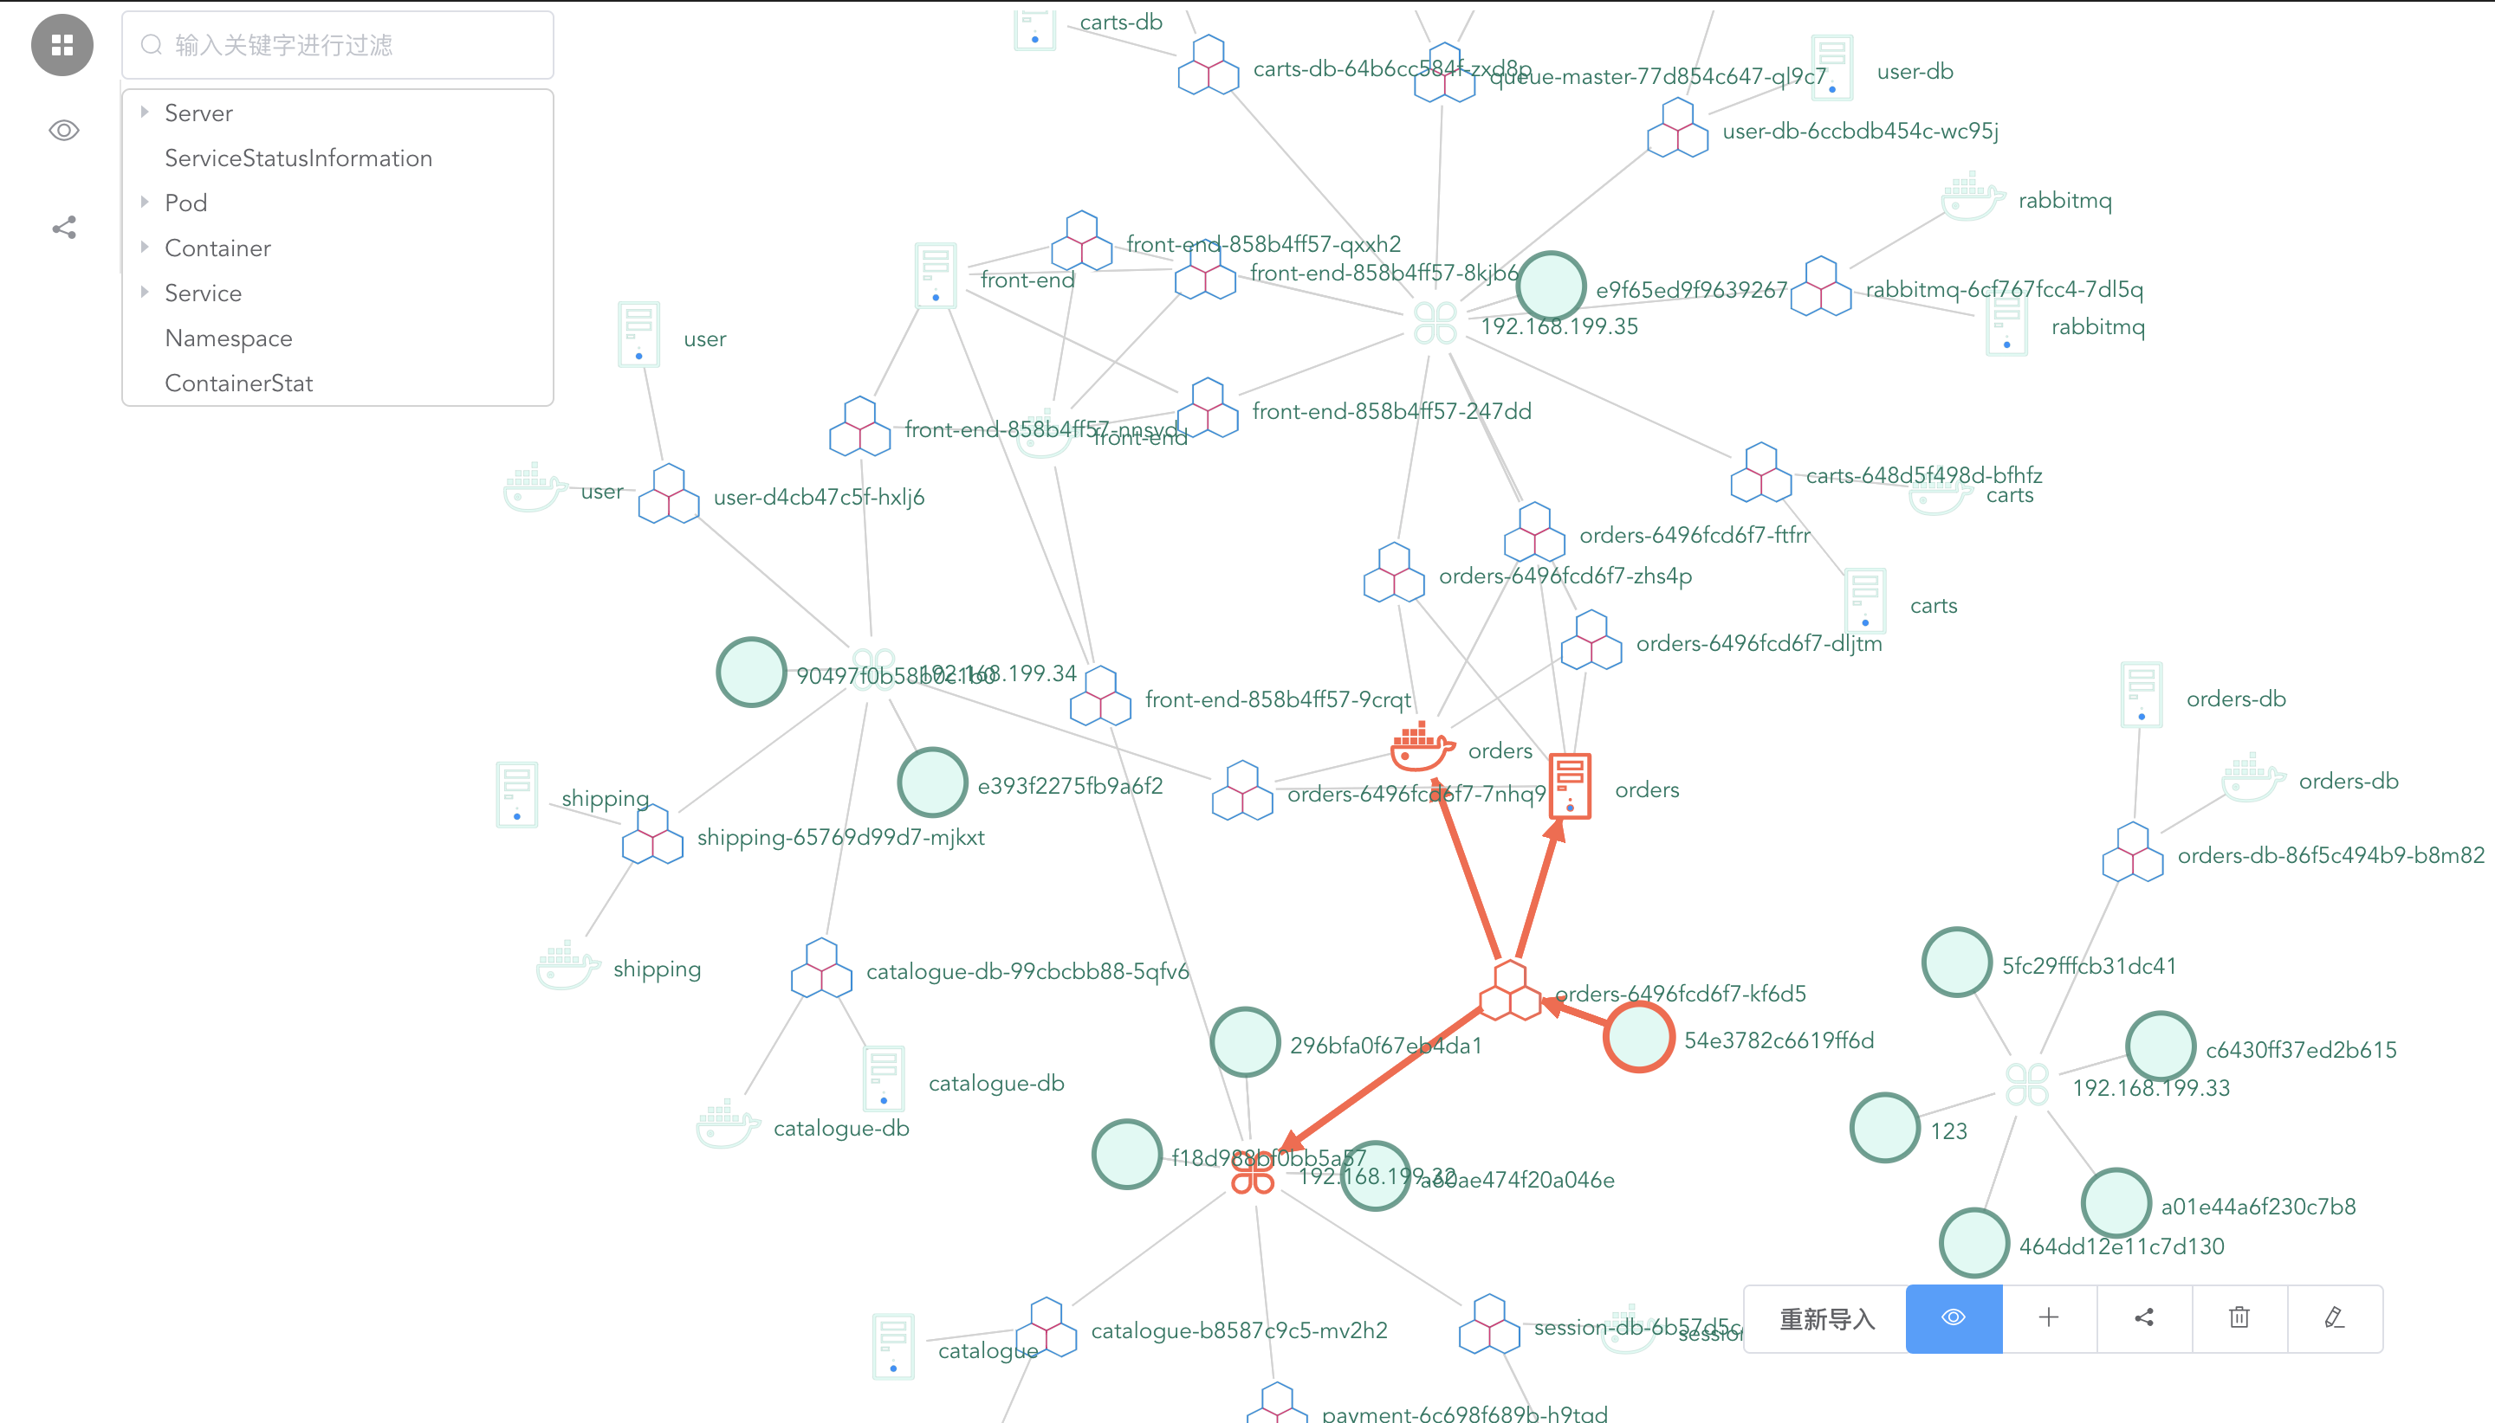
Requirement Engineering
Lab
Notes:
运维
对大型组织已经建立好的网络软硬件的维护

Slide 15
Requirement Engineering
Description
Build the metadata layer of knowledge Graph, so as to improve the structure of knowledge graph.
2. Three kinds of reasoning:
(1) Able to pass autonomously defined rules, obtain reasoning results based on this rule, and write the newly discovered knowledge into the database.
(2) Able to perform ontology inference on knowledge graphs and write the newly discovered knowledge into the database.
(3) Able to perform reasoning based on deep learning on knowledge graphs and write the newly discovered knowledge into the database.
3. Be able to import data into neo4j from fuseki and establish an intermediate layer to eliminate the impact of different knowledge repositories.

Slide 16
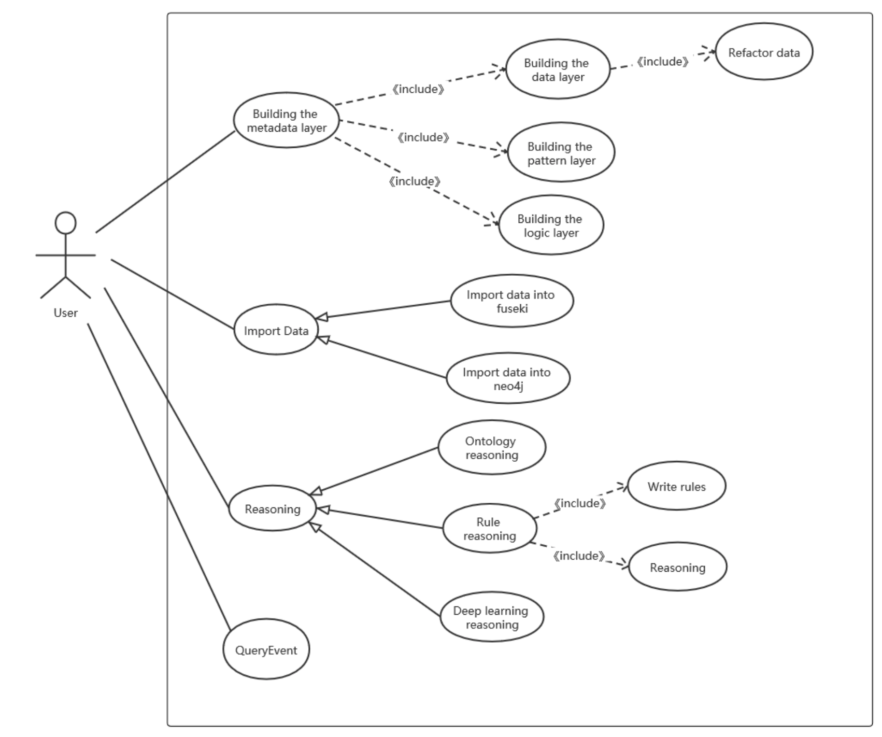
Requirement Engineering
UseCase Diagram

Slide 17
Requirement Engineering
UseCase Diagram
Building the Metadata Layer
Ontology Reasoning
Rule Reasoning
Deep Learning Reasoning——TransE Reasoning
Query Event

Slide 18
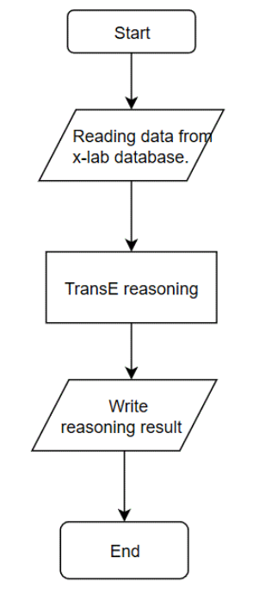
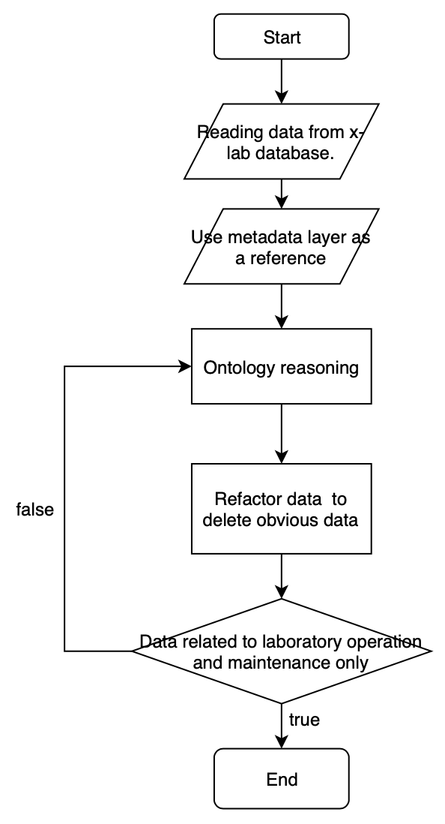
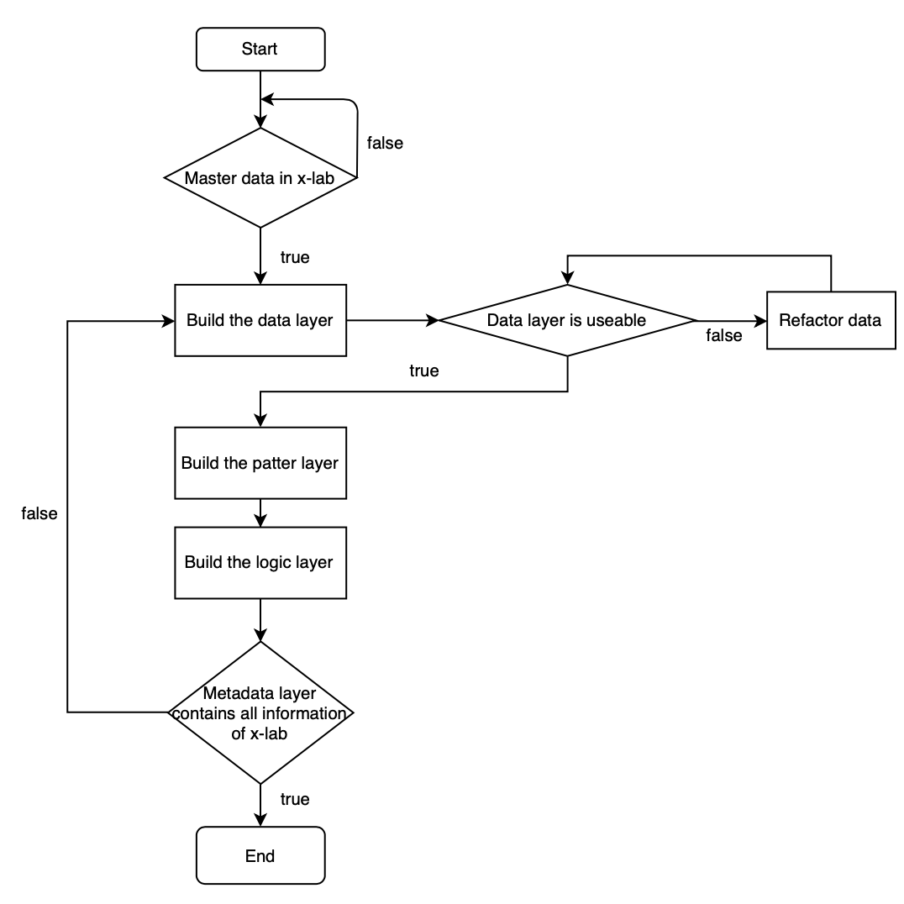
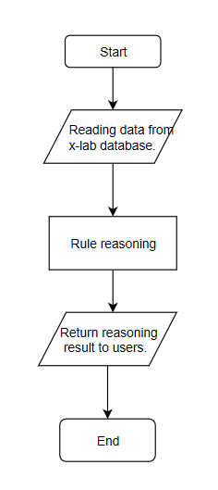
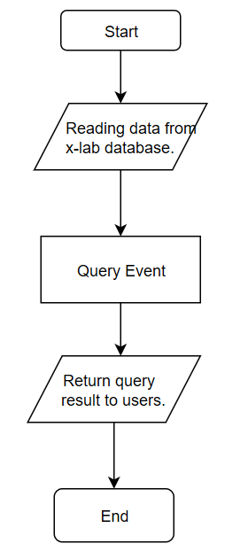
Requirement Engineering
UseCase Diagram
Building the Metadata Layer
Ontology Reasoning
Rule Reasoning
Deep Learning Reasoning——TransE Reasoning
Query Event

Slide 19
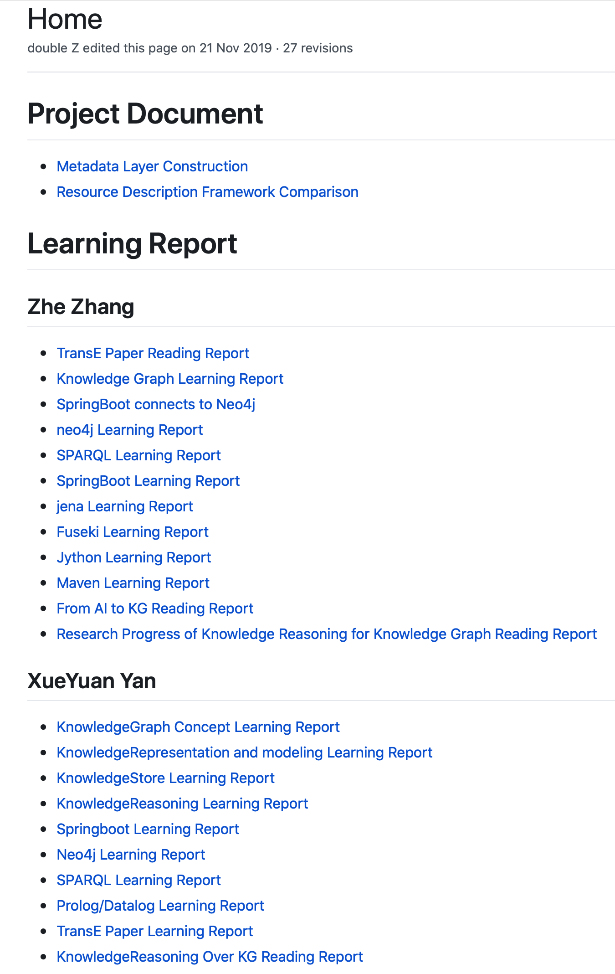
Requirement Engineering
Preparation
Preliminary theoretical knowledge
knowledge graph related knowledge
knowledge reasoning related knowledge
resource description framework:
RDF
n-triples
turtle
RDFS
OWL
Notes:
前期准备

Slide 20
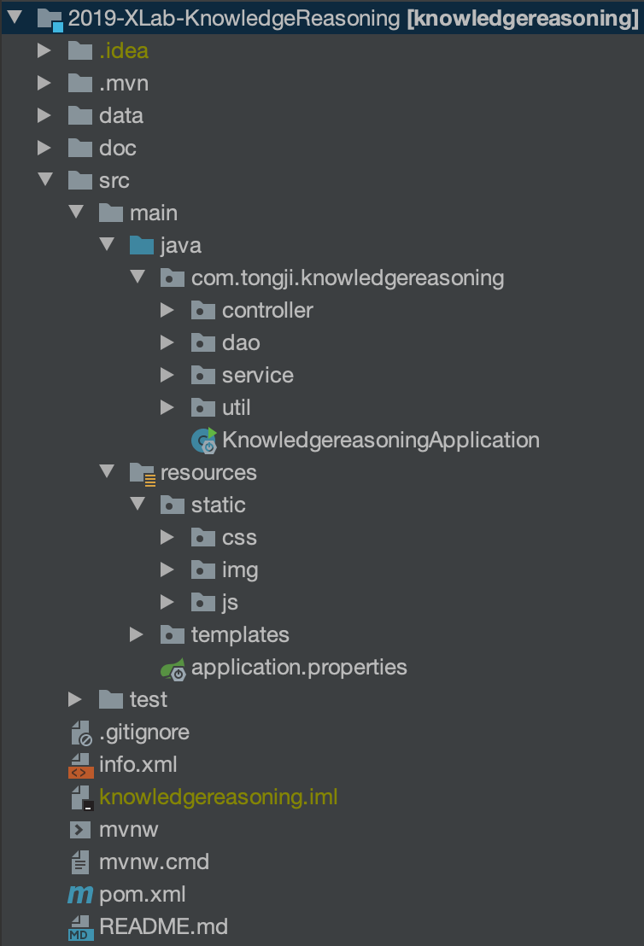
Requirement Engineering
Involves Tools
SpringBoot

Slide 21
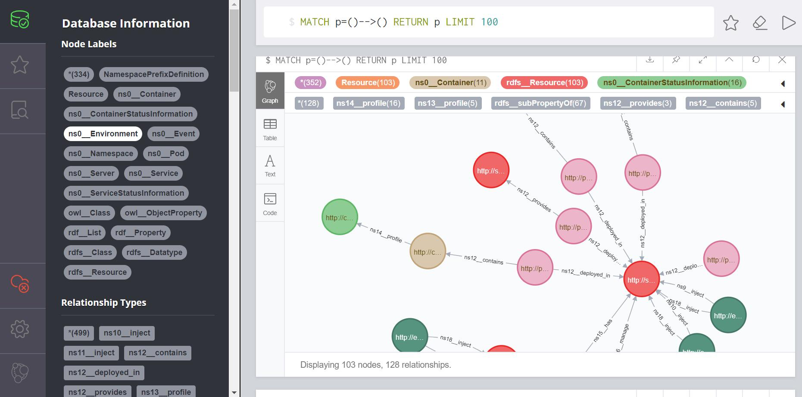
Requirement Engineering
Involves Tools
SpringBoot
Neo4j

Slide 22
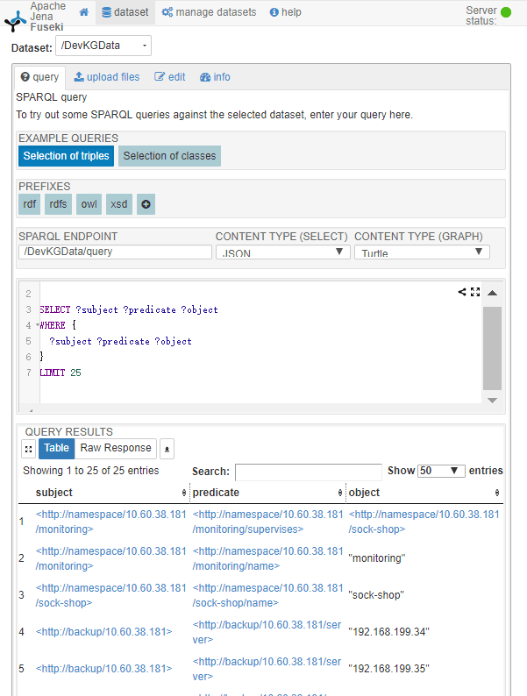
Requirement Engineering
Involves Tools
SpringBoot
Neo4j
Fuseki

Slide 23
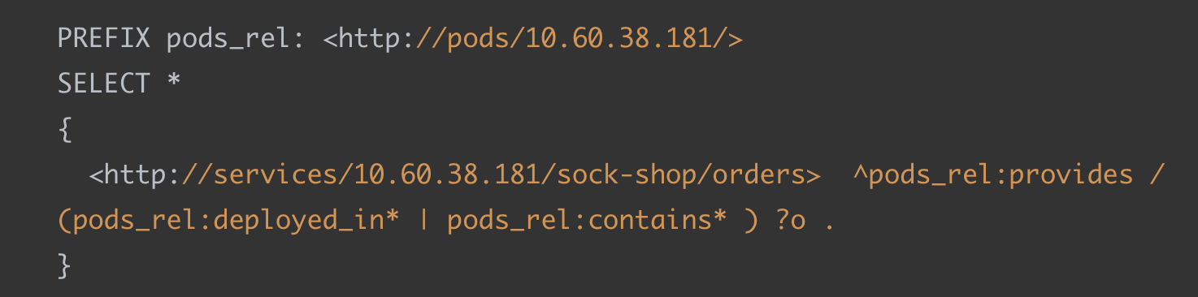
Requirement Engineering
Involves Tools
SpringBoot
Neo4j
Fuseki
SPARQL

Slide 24
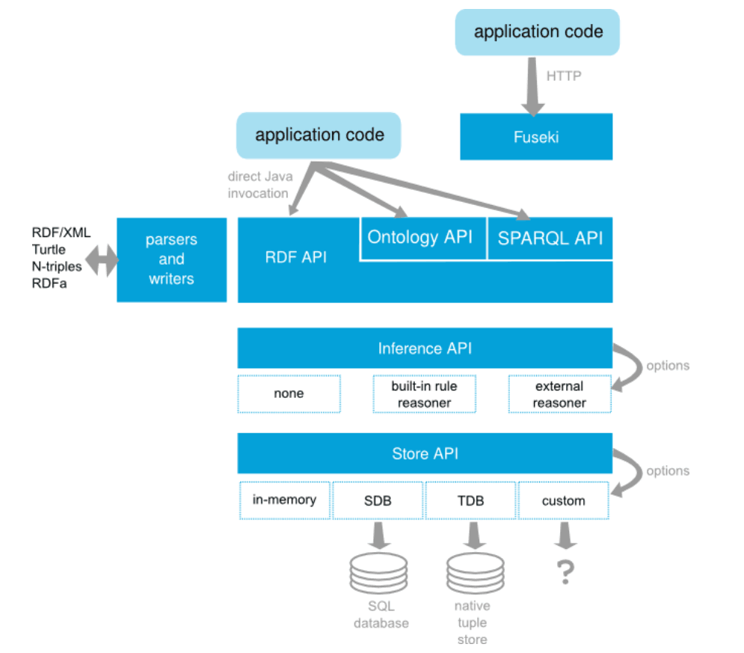
Requirement Engineering
Involves Tools
SpringBoot
Neo4j
Fuseki
SPARQL
jena

Slide 25
Process Model

Slide 26


Process Model --- Scrum
Role
Product Owner
Determine the function of the project.
For each sprint, adjust features and priorities as needed.
Inspection work of the development team.
Prof. Qingfeng Du
Link Team and Product owner.
Organize Daily Scrum, Sprint Review and Sprint Planning meetings.
Ensure good collaboration between members.
Resolve obstacles in team development.
Scrum Master
Senior Yongqi Han
Team
Mainly responsible for product development.
Deliver potentially deliverable product increments after each Iteration. Ensure that the goals of the Sprint are achieved.
Zhe Zhang
Xueyuan Yan

Slide 27
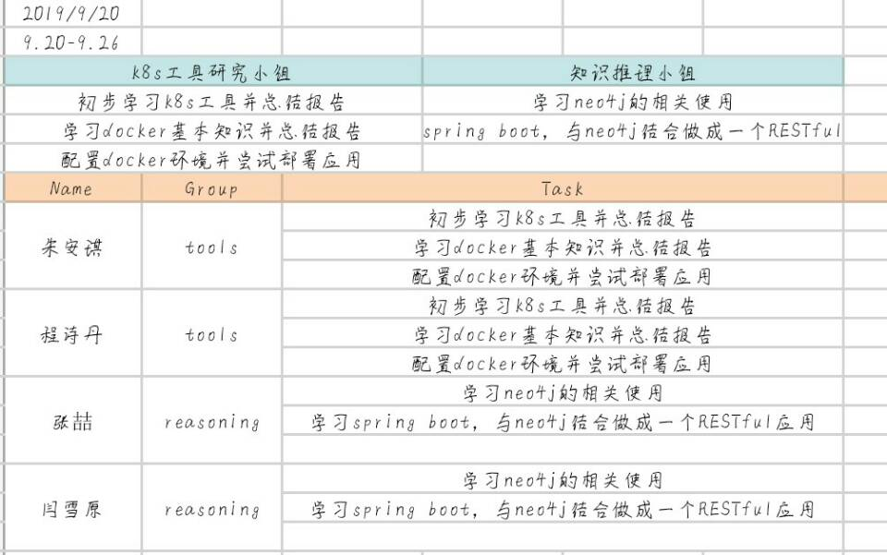
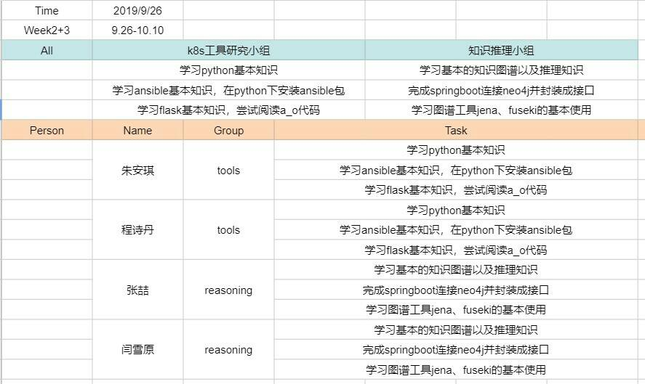
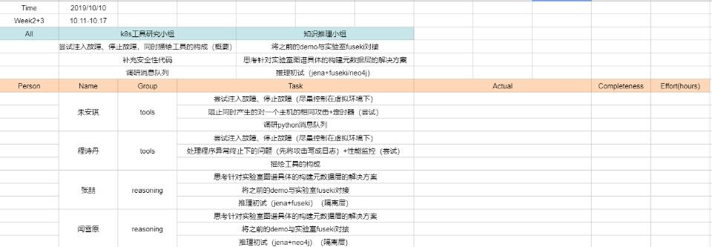
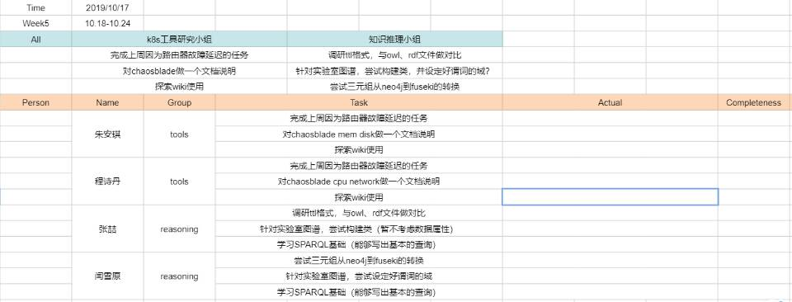
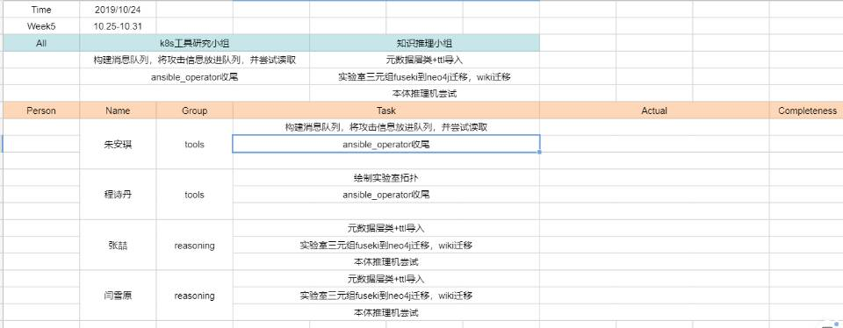
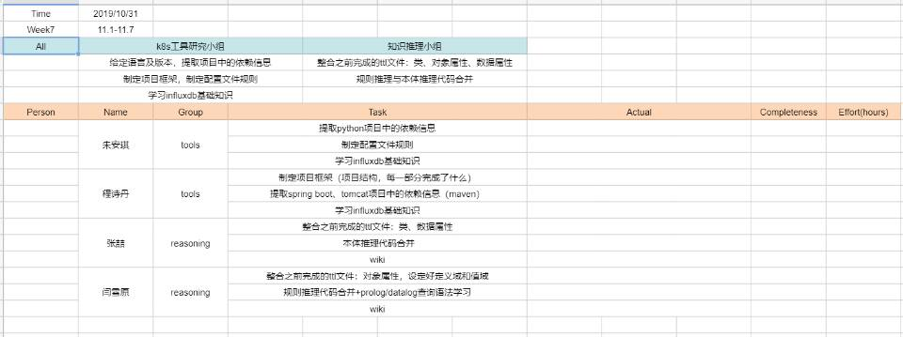
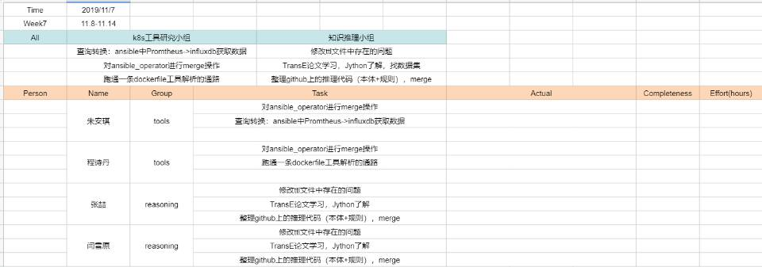
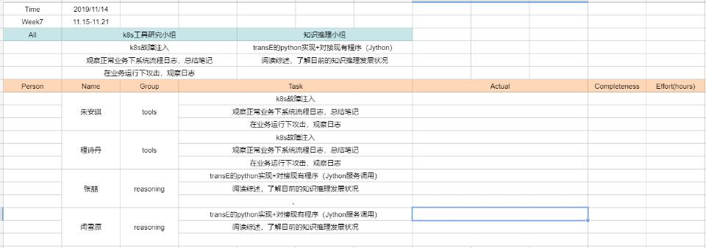
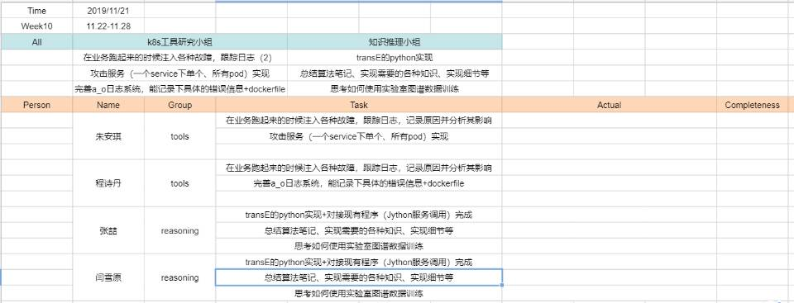
Process Model --- Scrum
Backlog

Slide 28
Process Model --- Scrum
Backlog

Slide 29
Process Model --- Scrum
Backlog

Slide 30
Process Model --- Scrum
Backlog

Slide 31
Process Model --- Scrum
Backlog

Slide 32
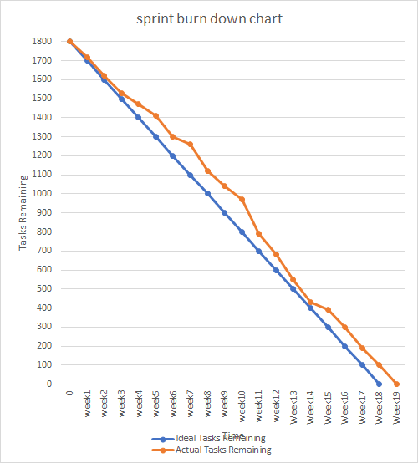
Process Model --- Scrum
Work Product
Burn Down Chart

Slide 33




Process Model --- Scrum
Meeting
Planning meeting
Every Thursday at 19:00
Arrange next week's task
Daily meeting
Discuss how to get the job done in the team every day
Review meeting
On November 14, Prof. Du personally participated in the discussion, and we showed the results of the previous stage to the teacher.
Retrospective meeting
Every Thursday at 19:00, review last week's accomplishments before the planning meeting and dynamically adjust the tasks for the next week

Slide 34
Modeling

Slide 35
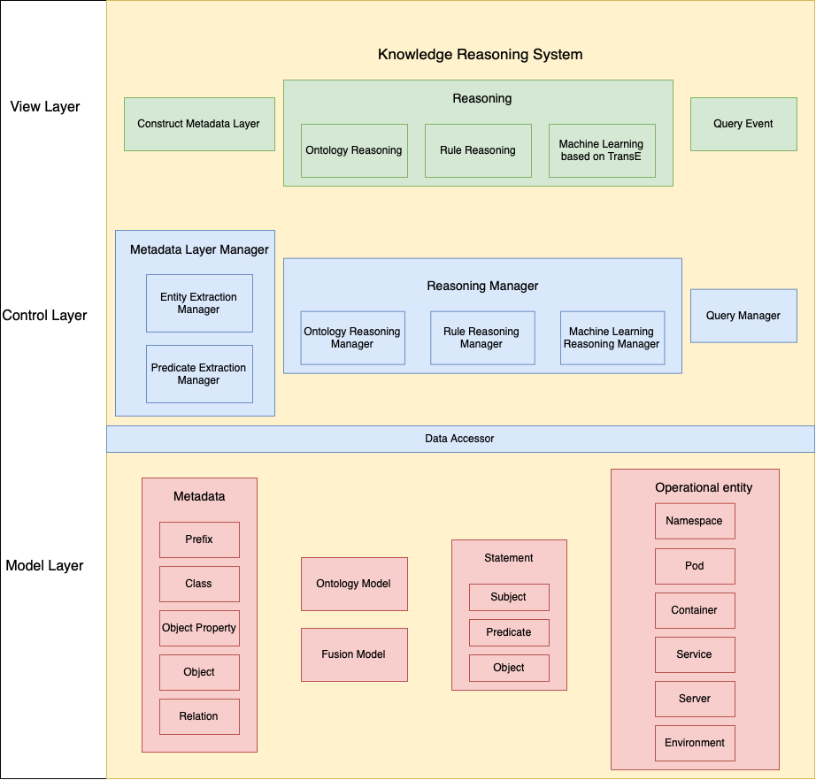
High level Design
Business Architecture

Slide 36
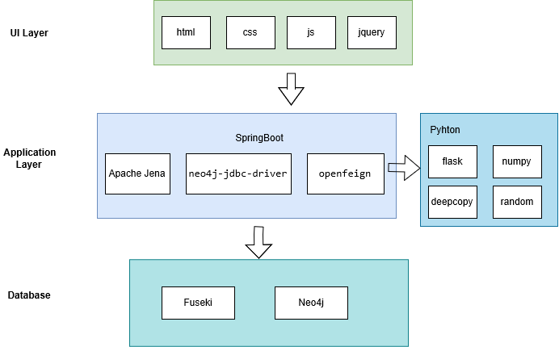
High level Design
Technology Architecture

Slide 37
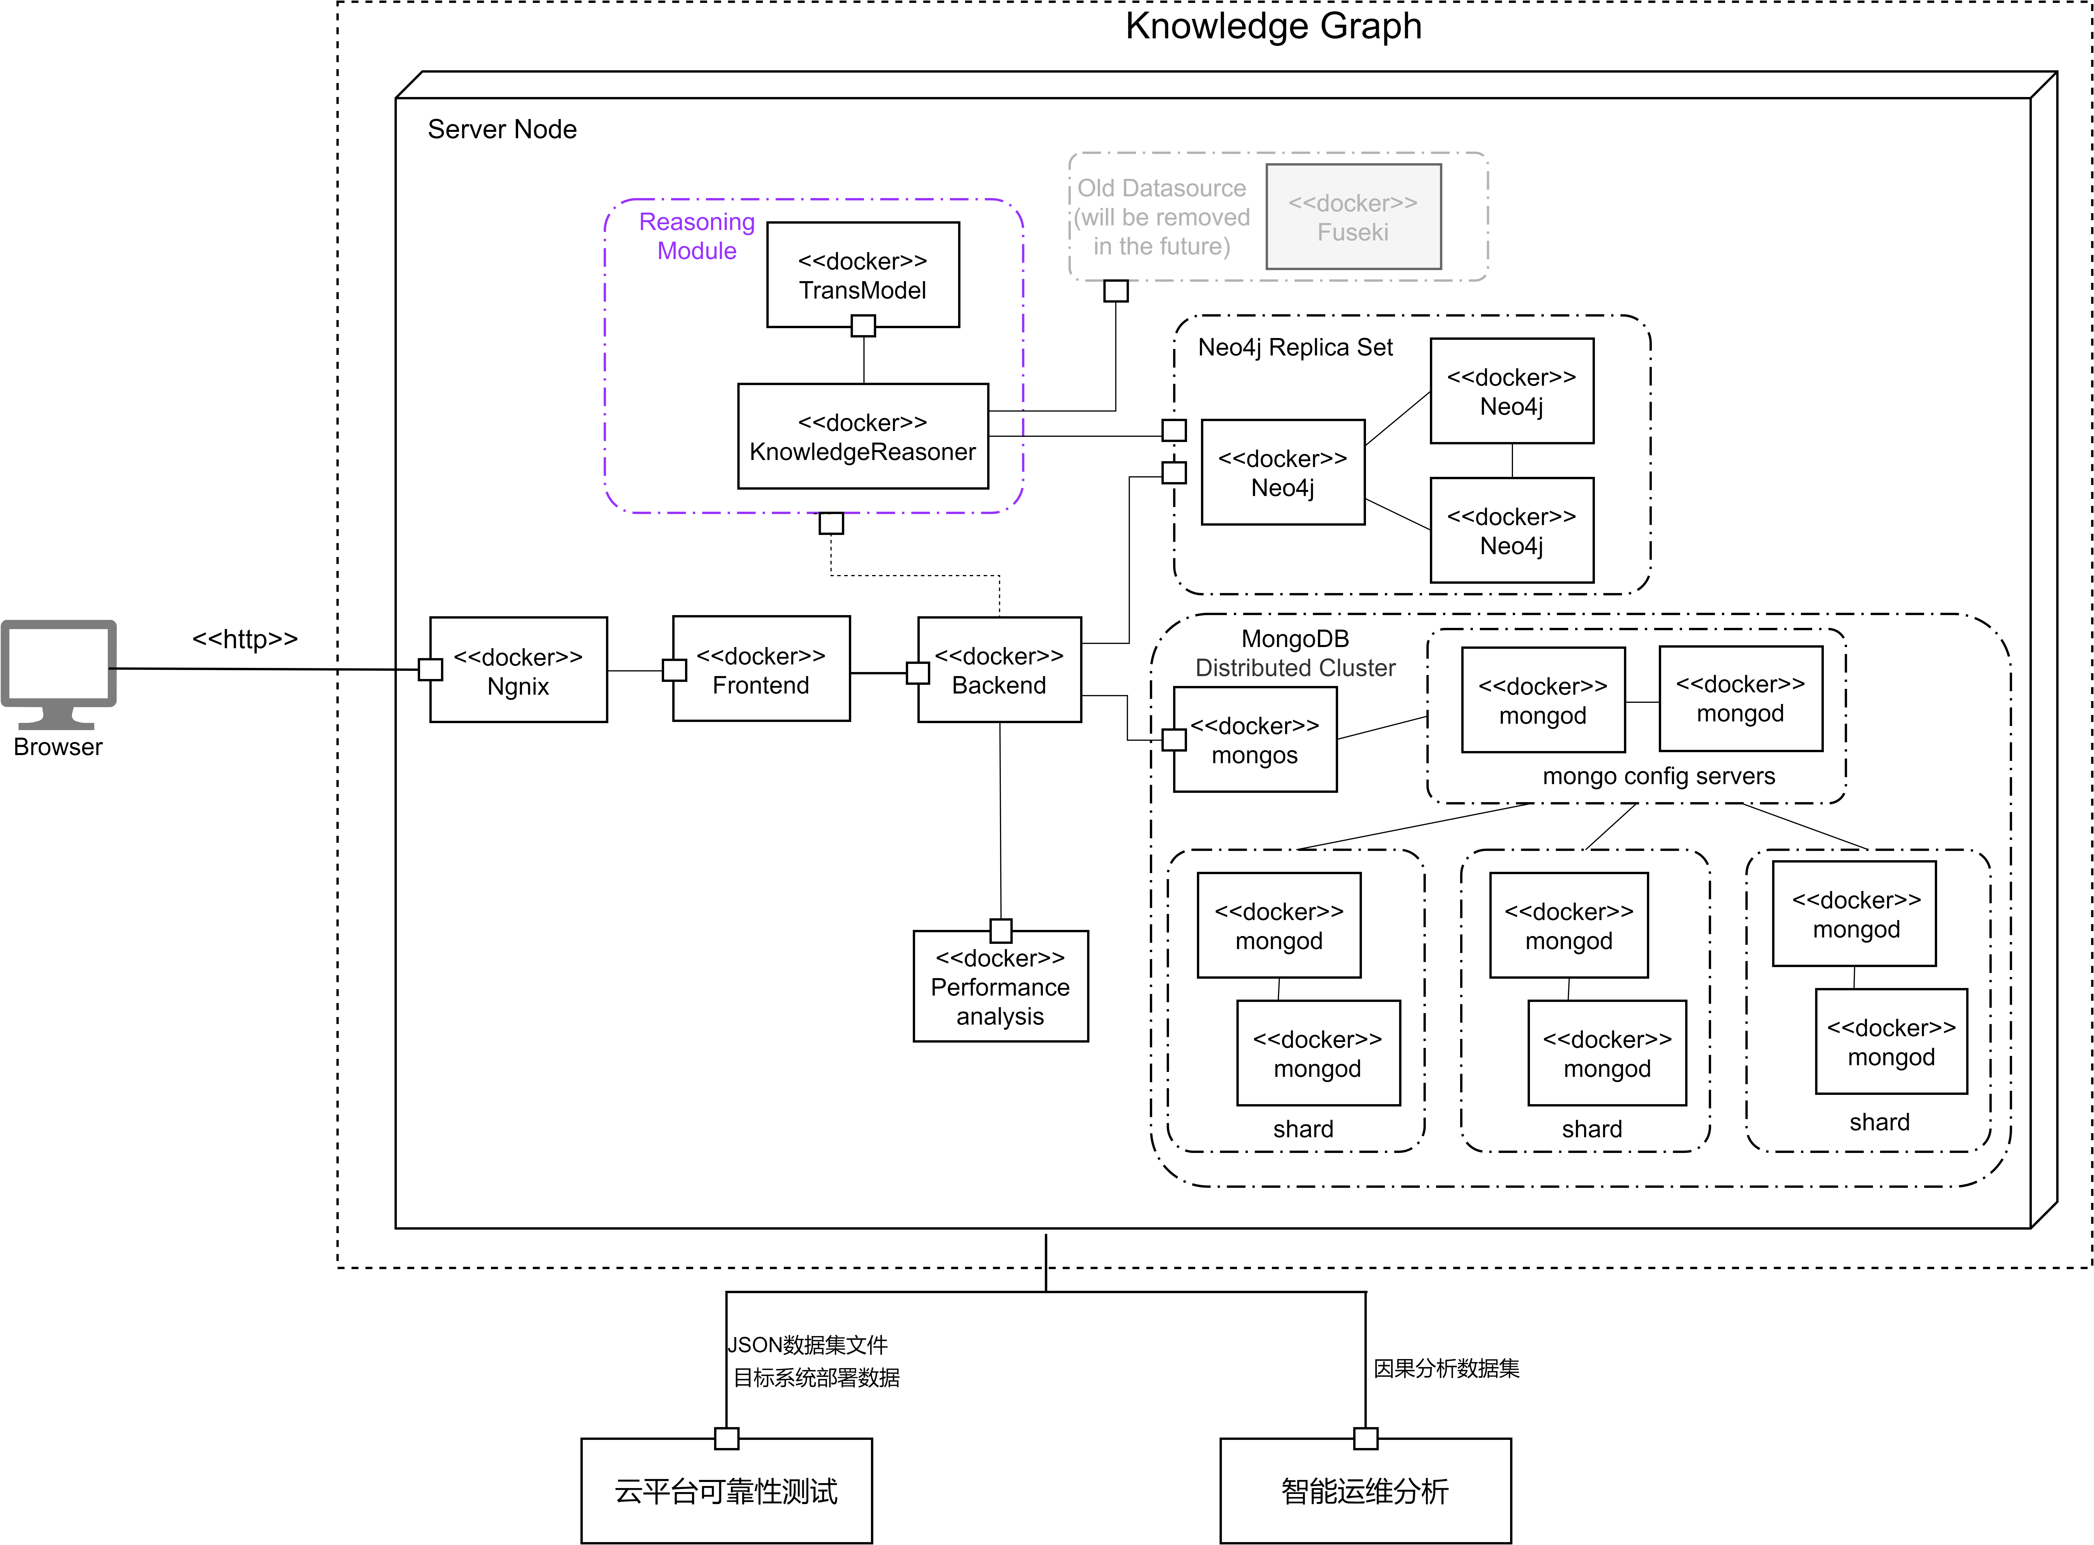
High level Design
Deployment Topology

Slide 38
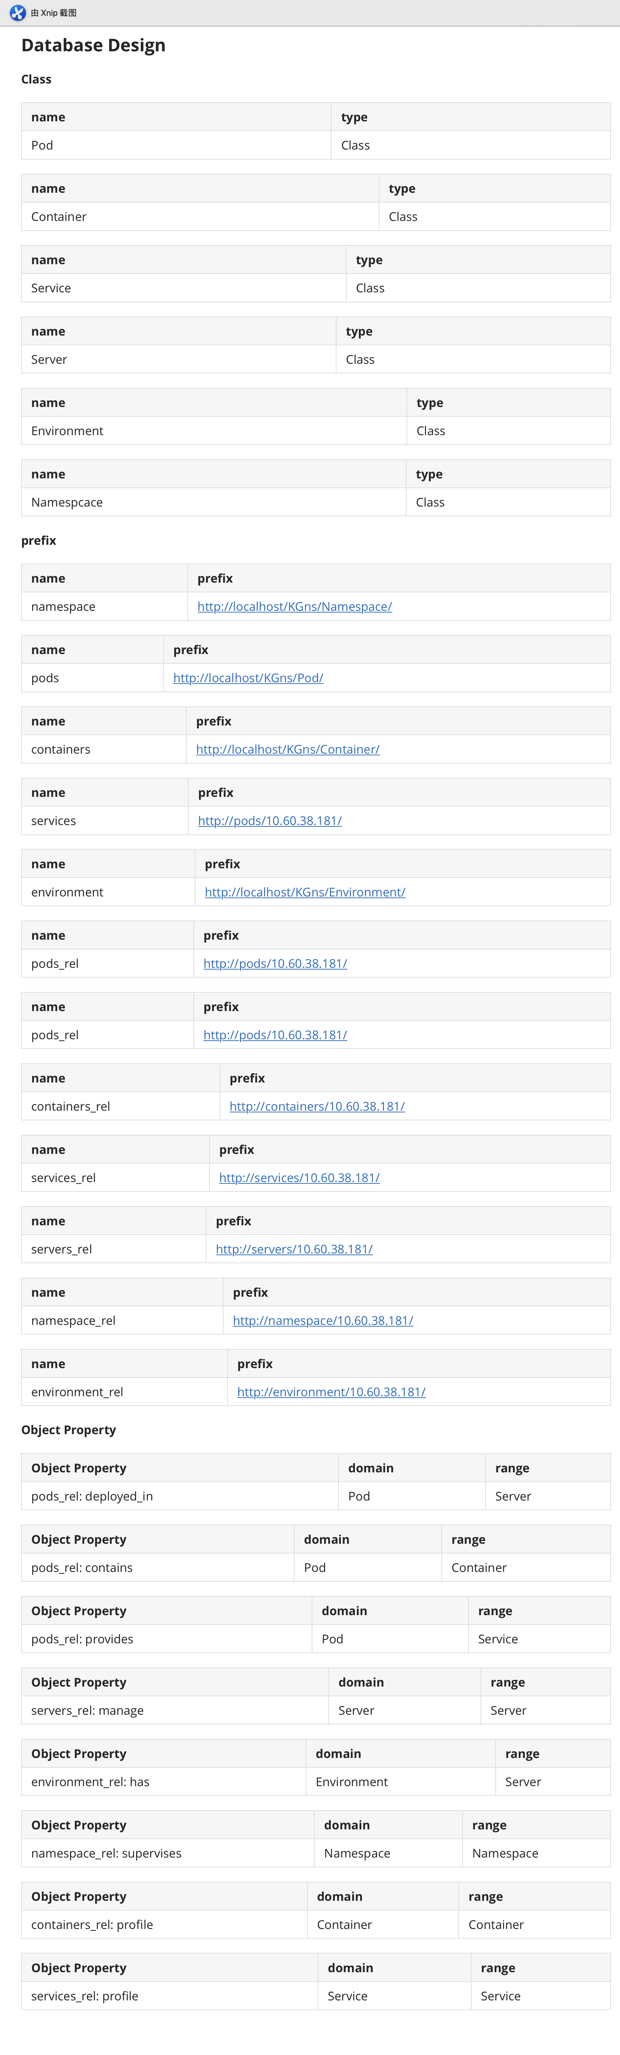
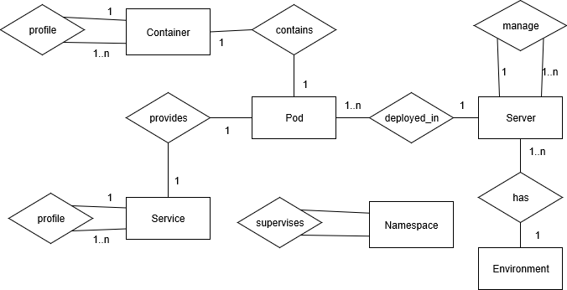
High level Design
Database Design
Data Model
Entity Relationship Design

Slide 39
High level Design
Database Design
Data Model
Entity Relationship Design

Slide 40
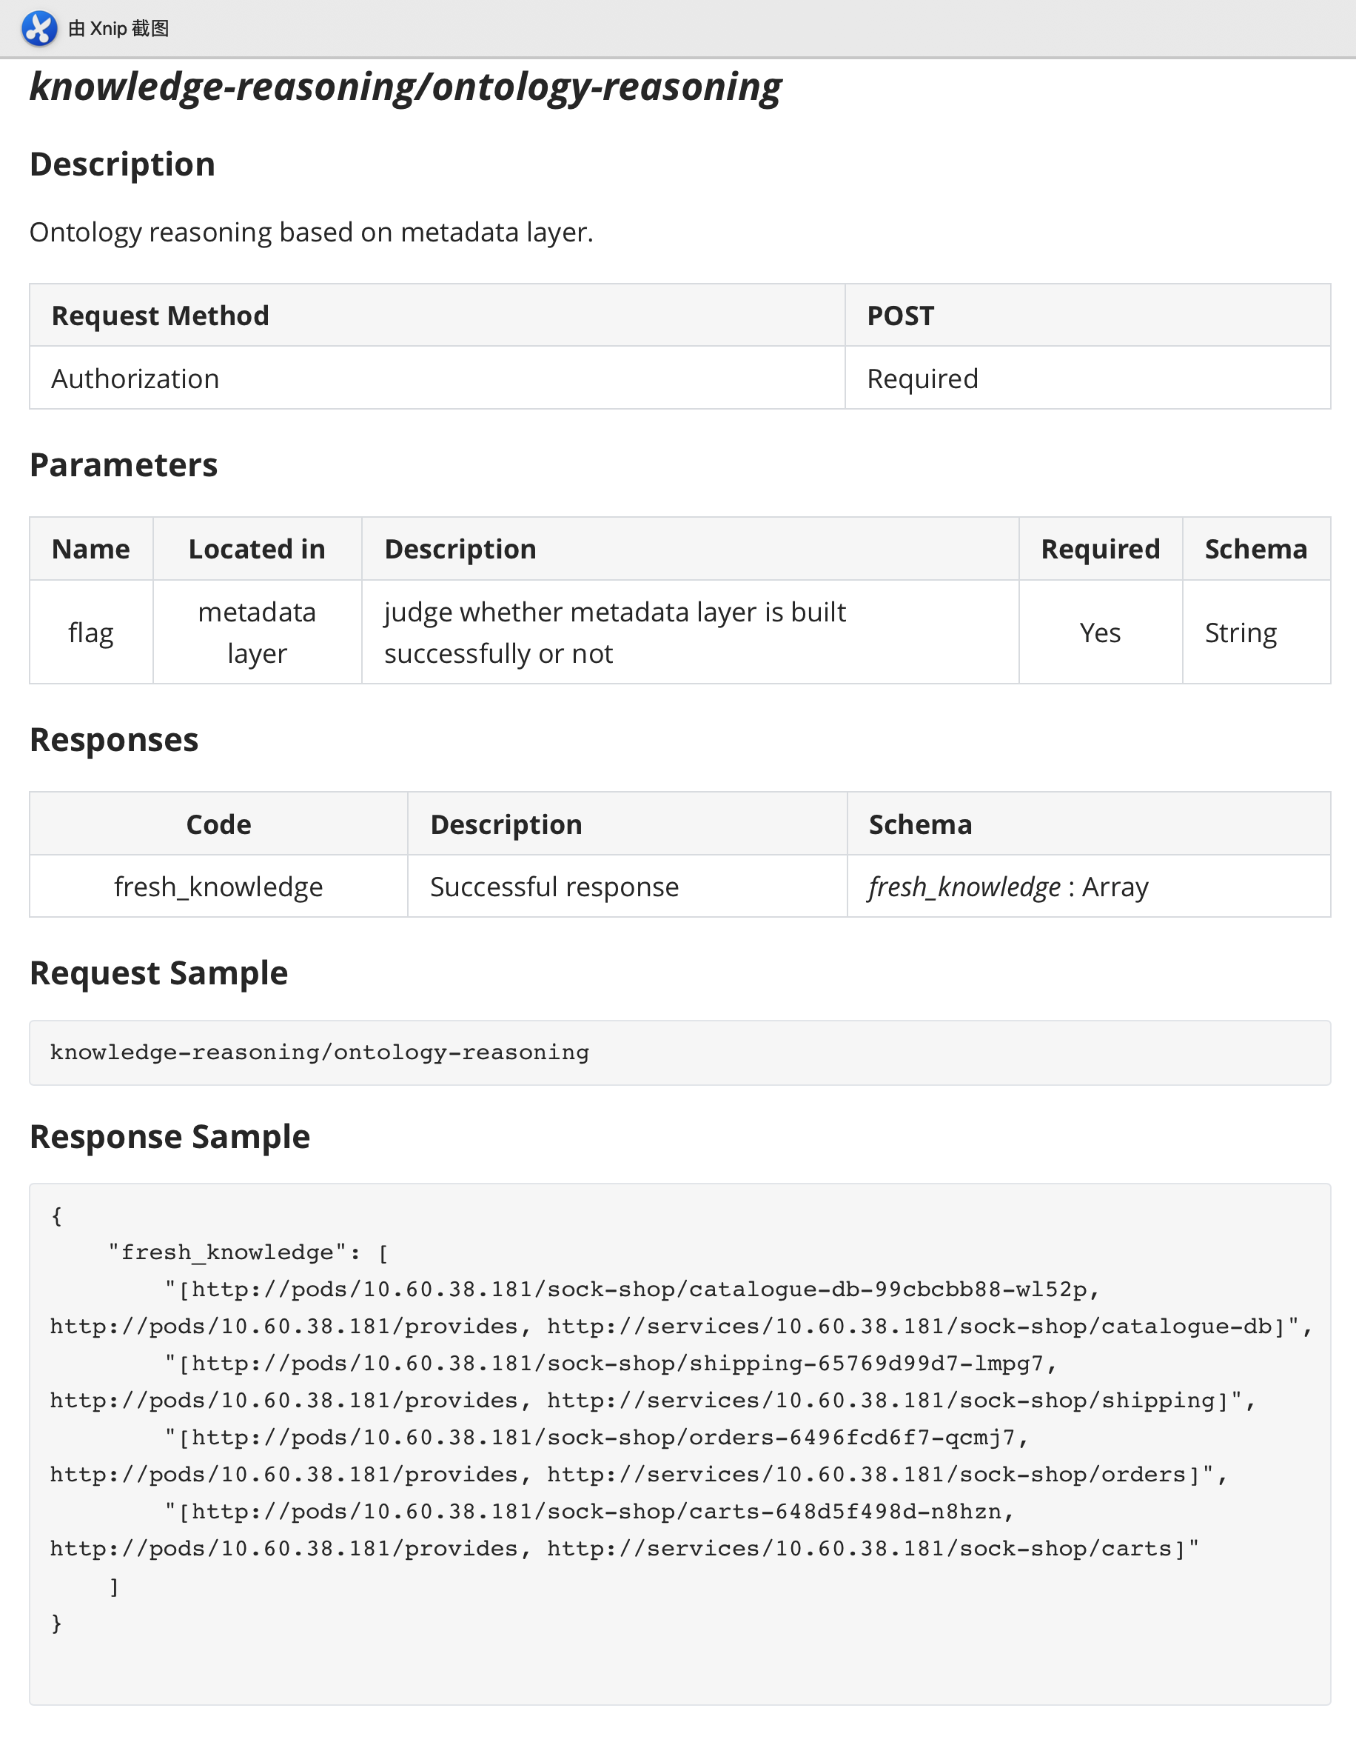
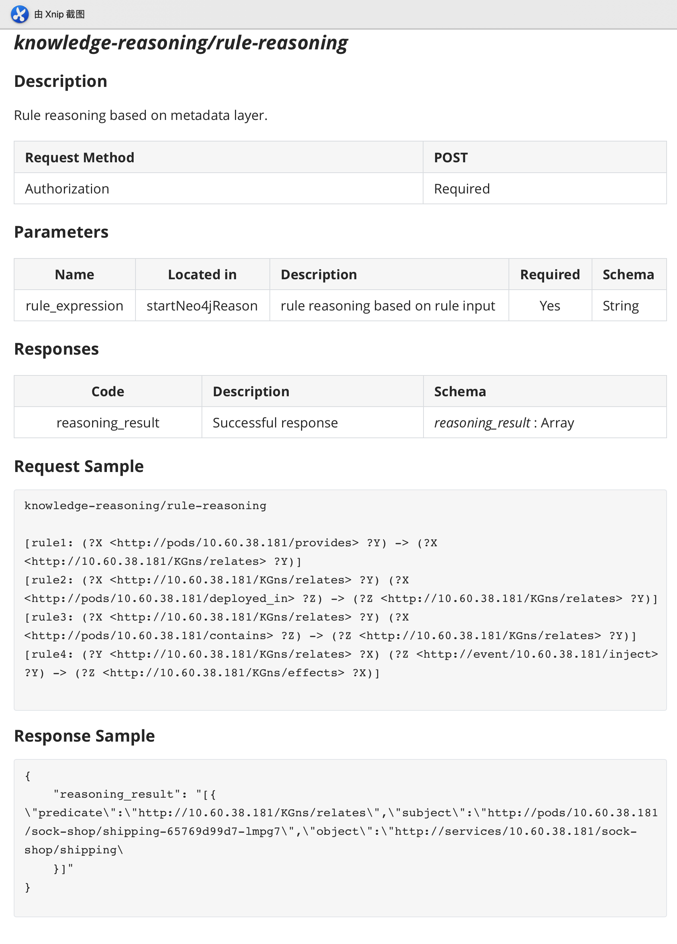
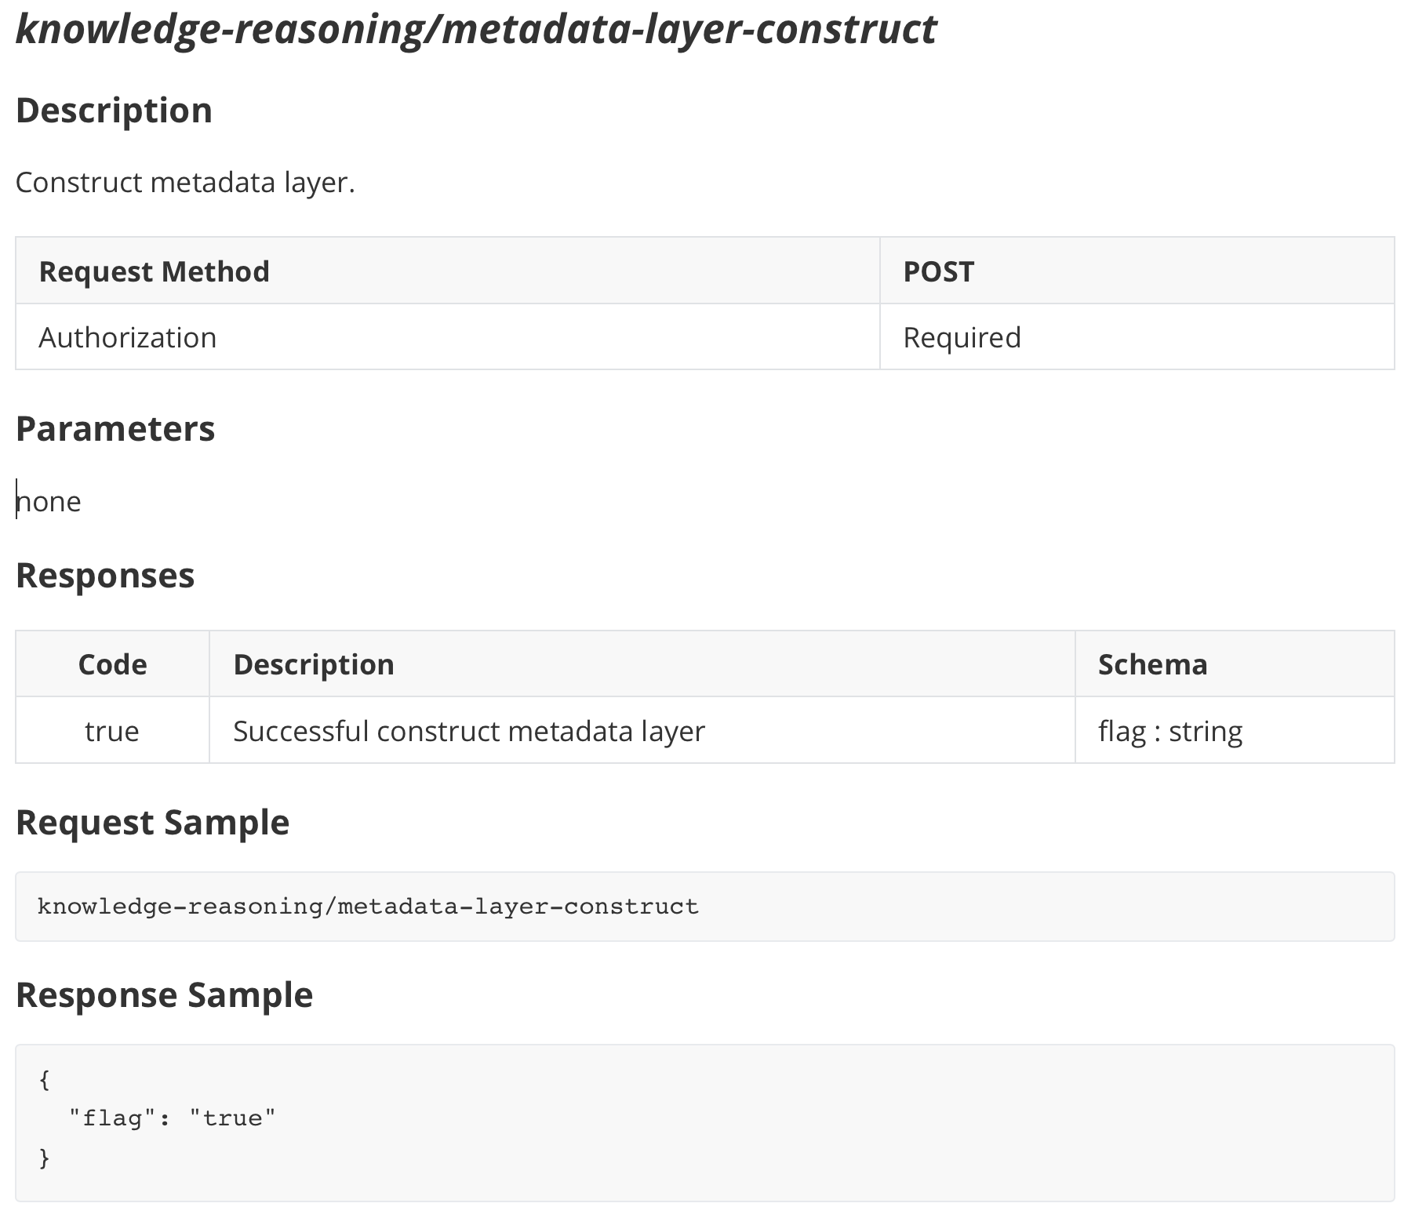
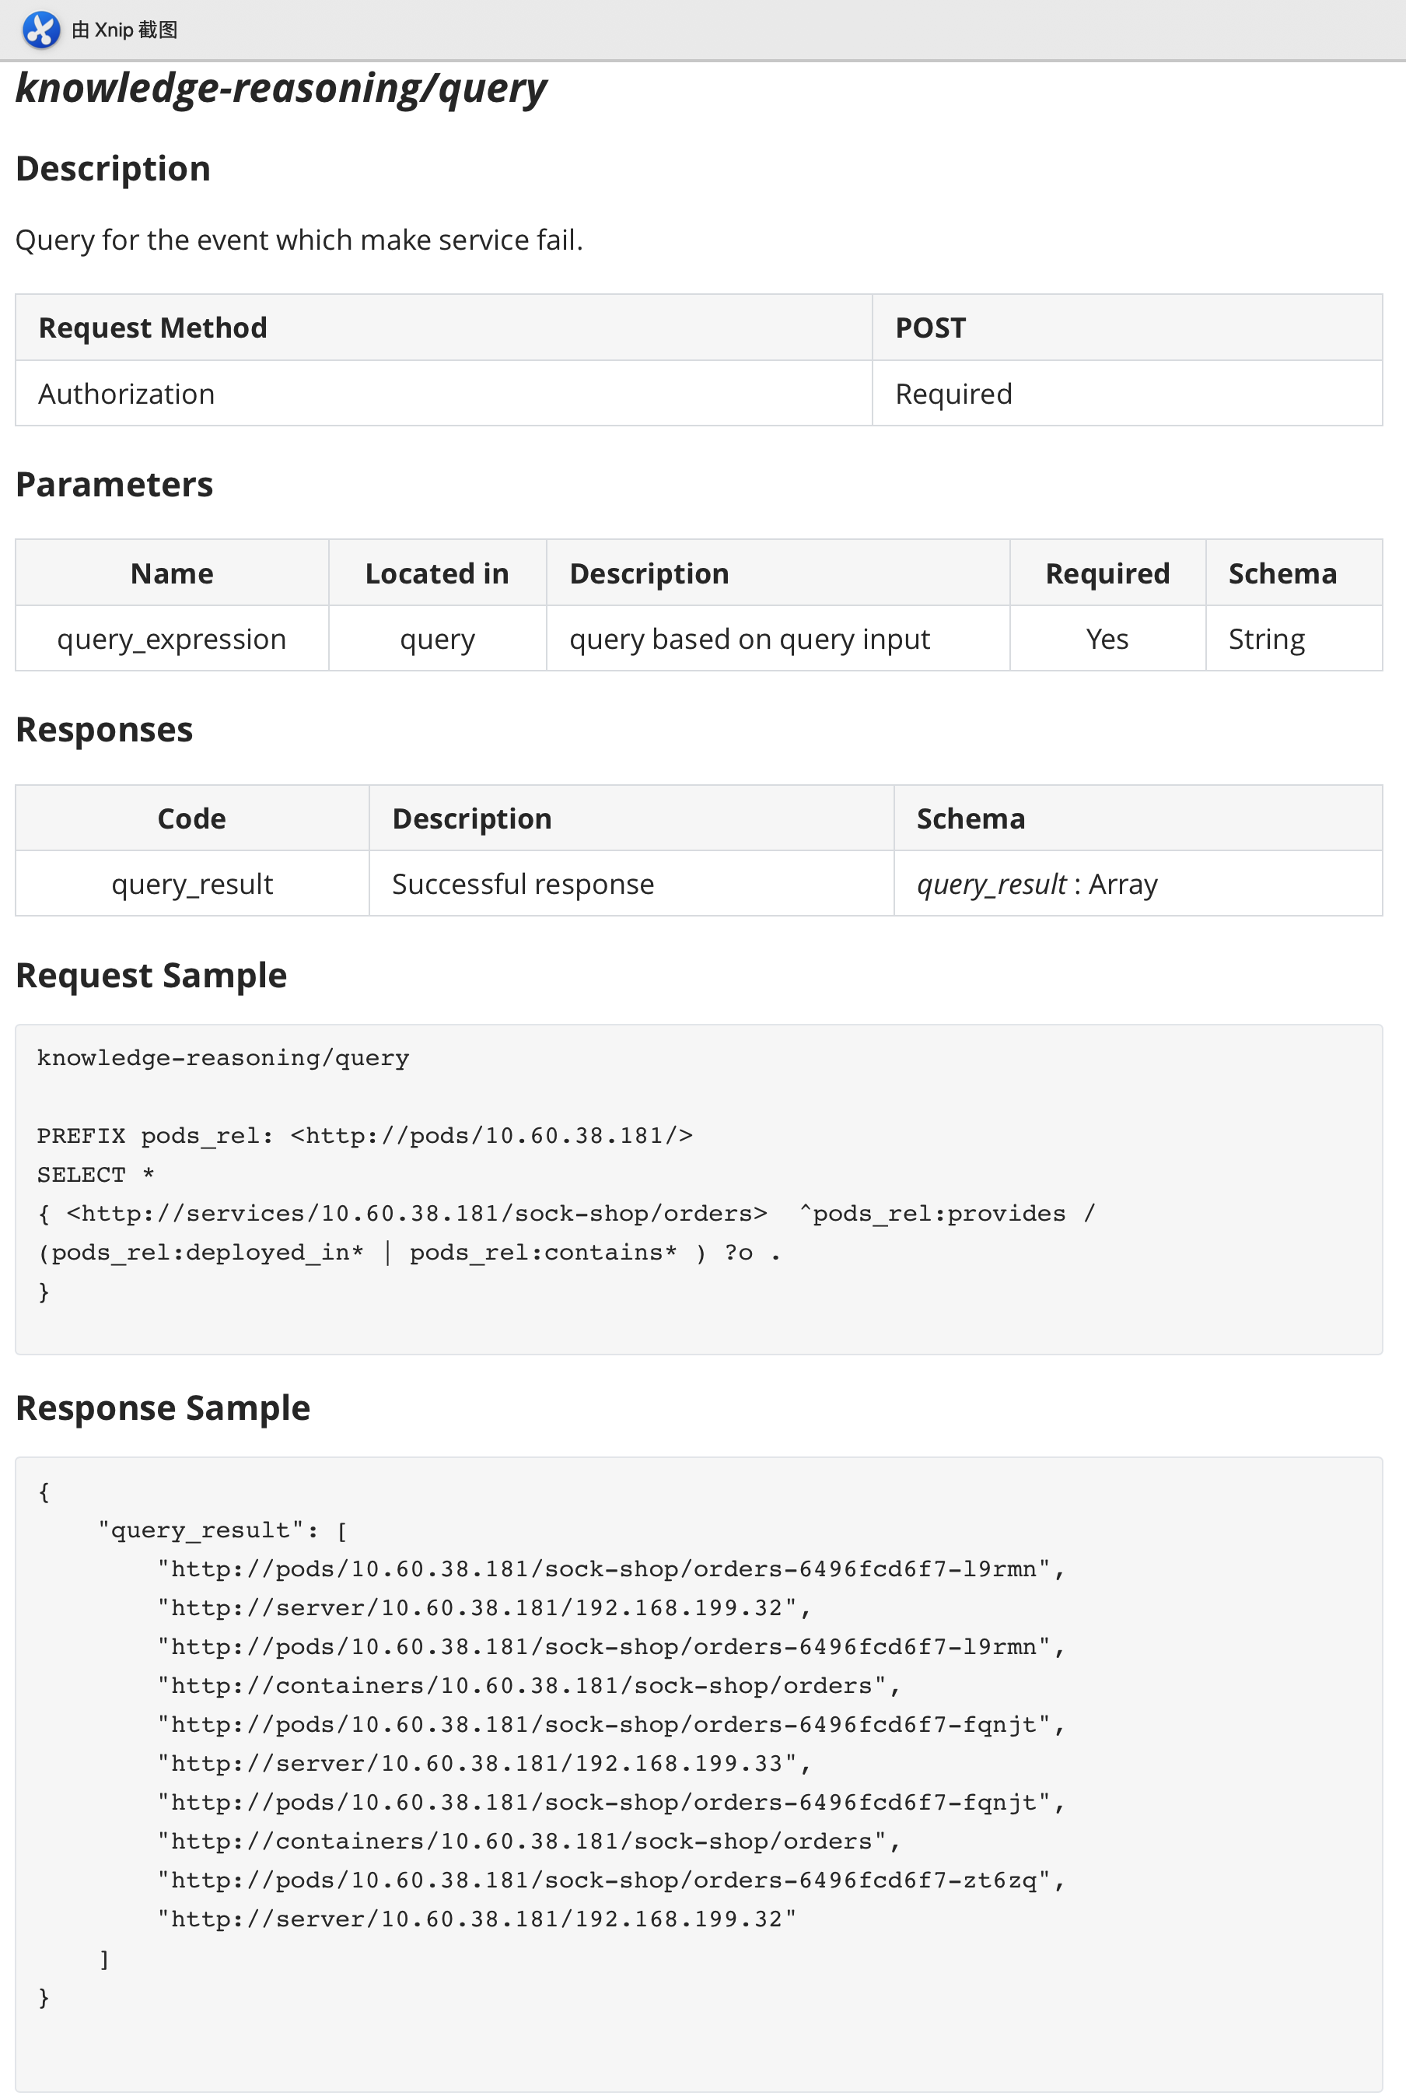
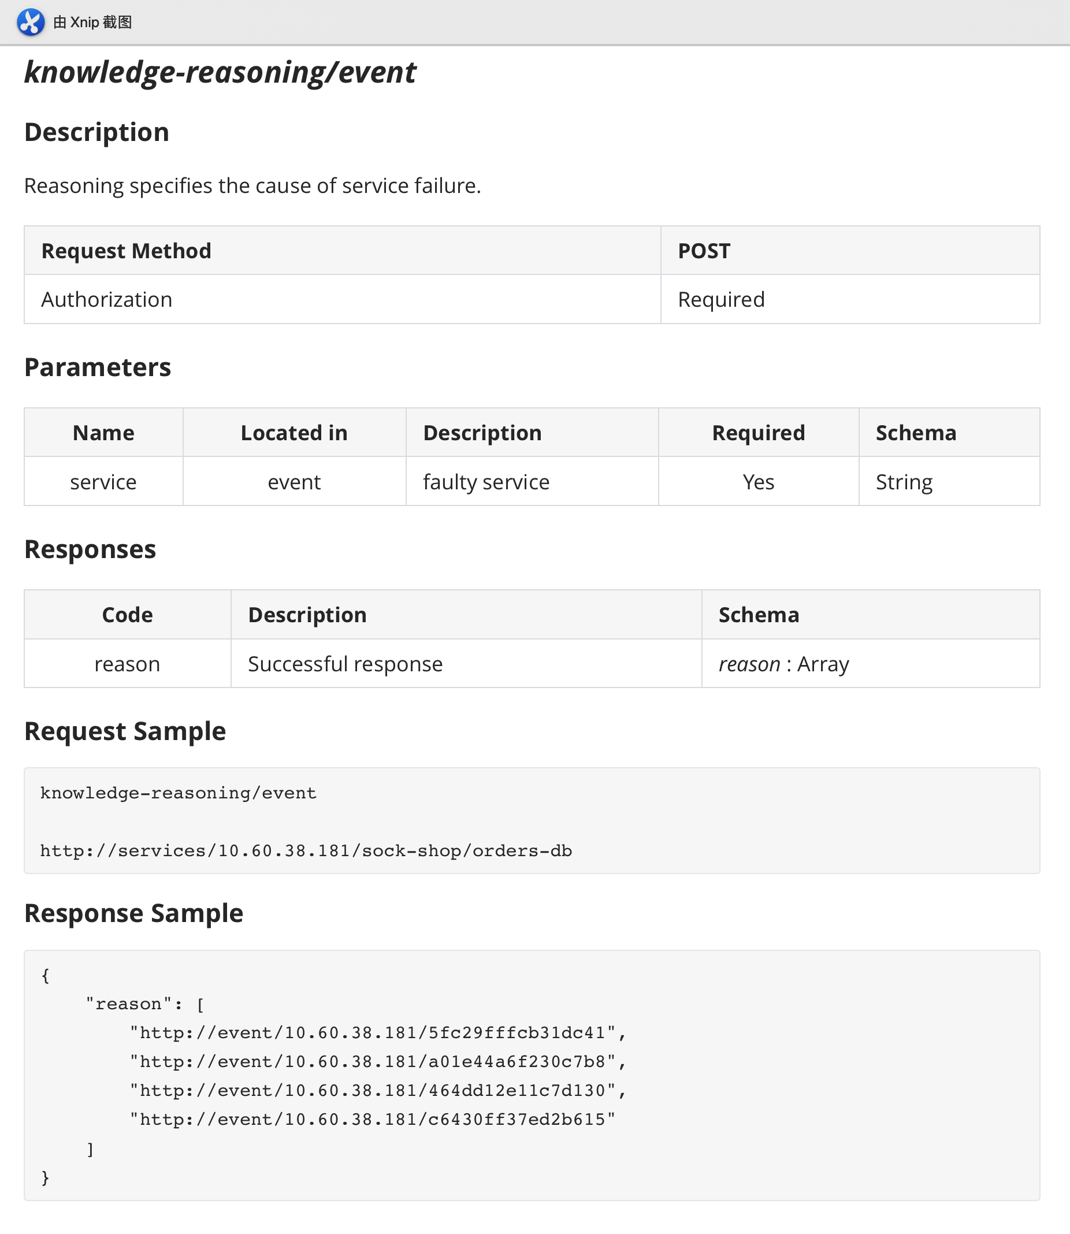
High level Design
Interface Specifications

Slide 41
High level Design
Interface Specifications

Slide 42
High level Design
Interface Specifications

Slide 43
High level Design
Interface Specifications

Slide 44
High level Design
Interface Specifications

Slide 45
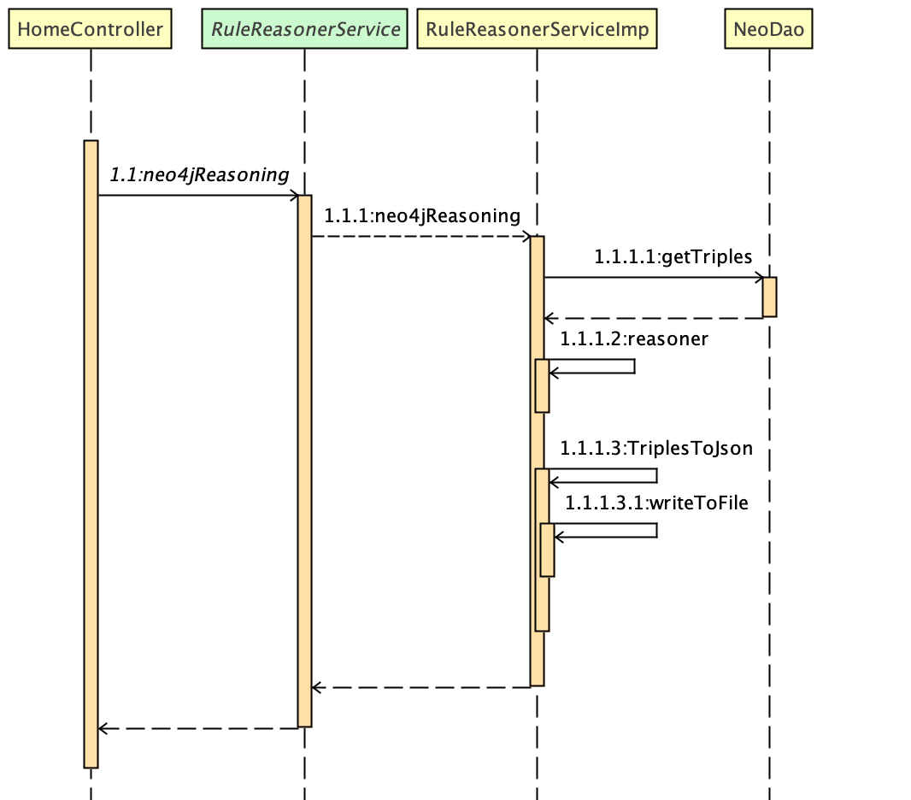
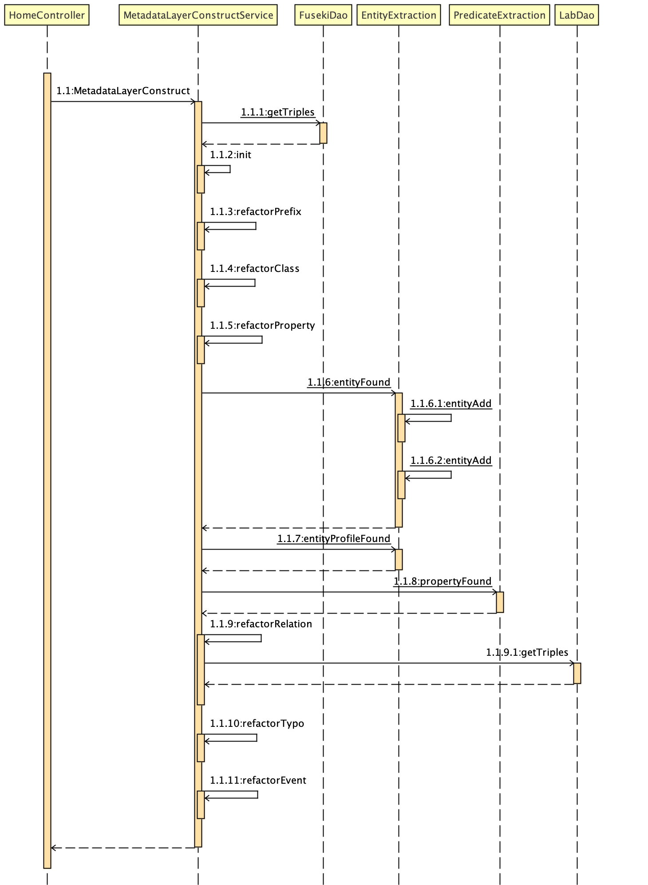
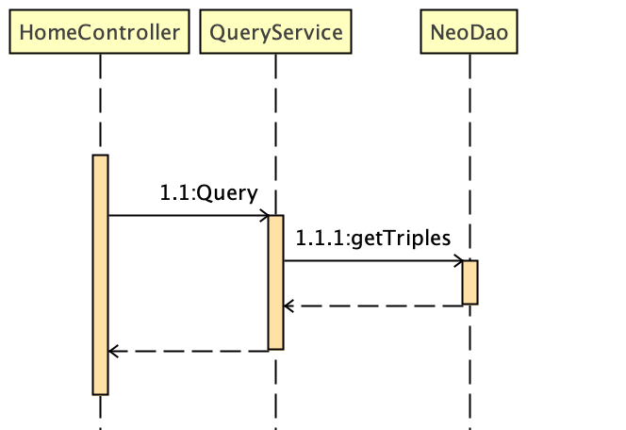
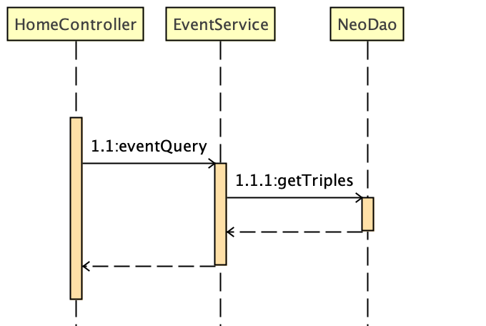
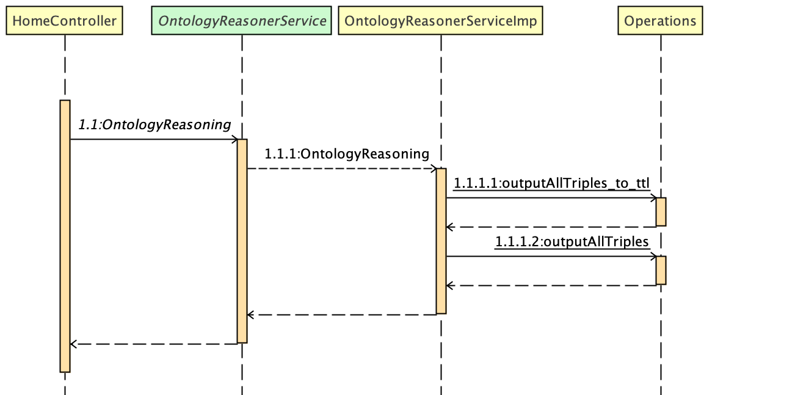
Detailed Design
Process Flow Design

Slide 46
Detailed Design
Process Flow Design

Slide 47
Detailed Design
Process Flow Design

Slide 48
Detailed Design
Process Flow Design

Slide 49
Detailed Design
Process Flow Design

Slide 50
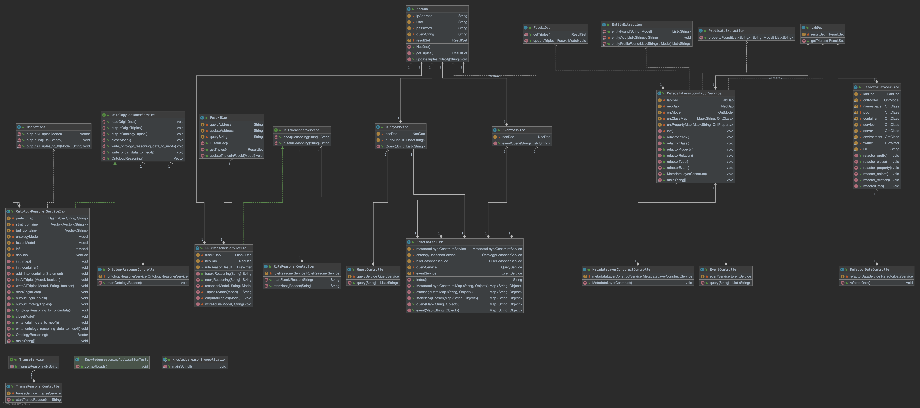
Detailed Design
Class Design

Slide 51
Construct

Slide 52
Construct
Algorithm Design
Metadata Layer
Build Reason
RDF has limited expressiveness: it lacks abstraction
extended map implied information (knowledge reasoning)

Slide 53
Construct
Algorithm Design
Metadata Layer
Data Layer
The construction of RDF triples does not involve abstractions
Basic class and object concepts (RDFS)
Build basic classes, and relatively simple relationships
Main class in Lab Knowledge Graph
purely physical: server environment
purely logical level: namspace service
based on physical + logical level: pod container
Model Layer
Logic Layer
Complex logic involved (owl)
Build object properties and data properties

Slide 54
Construct
Metadata Layer
Read data from lab dataset.
Distinguish between entities.
operation and maintenance entities: entityType
state information corresponding to these operation and maintenance entities: StatusInformation
Set the corresponding map for each entity and relationship.
Refactor prefix.
Refactor class.
Refactor property.
Refactor relation.
Refactor event.
Algorithm Design

Slide 55
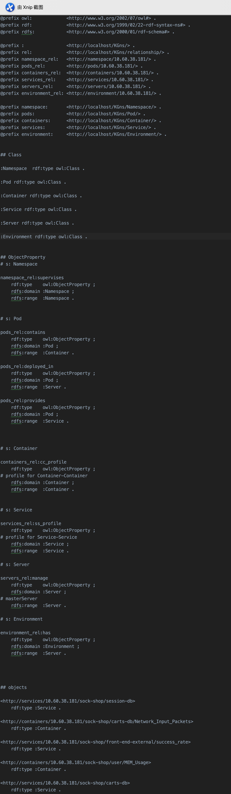
Construct
Algorithm Design
Metadata Layer

Slide 56
Construct
Algorithm Design
Metadata Layer

Slide 57
Construct
Algorithm Design
Metadata Layer

Slide 58
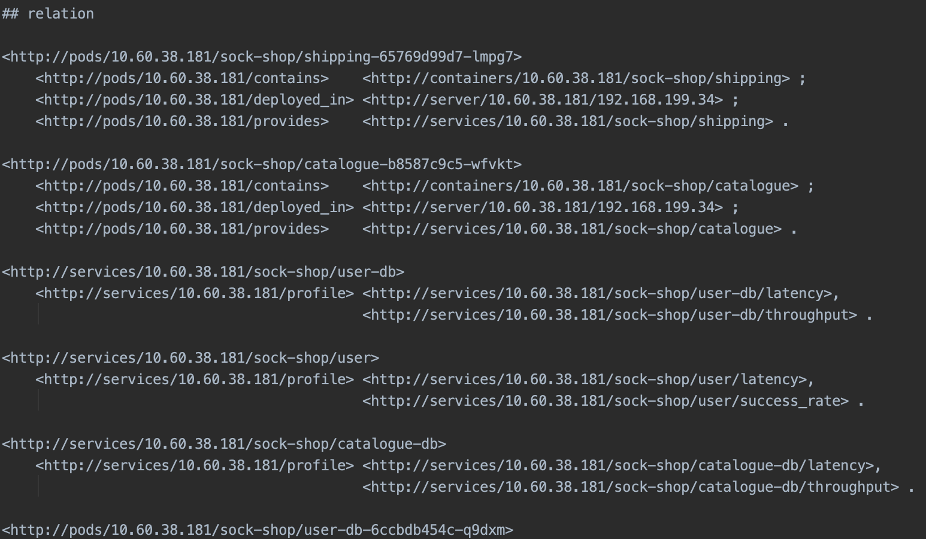
Construct
Algorithm Design
Metadata Layer

Slide 59
Construct
Algorithm Design
TransE
Core idea
Transforms triples into low-dimensional vectors, which we call embedding vectors. After they become vectors, many mathematical methods can be used for further processing.

Slide 60
Construct
Algorithm Design
TransE

Slide 61
Construct
call _init_() to initialize triples, vector dimensions, distance calculation formulas, etc.
callinitialize(self)to initialize the vector.
1.Randomly value each dimension of each entity and relation through the function uniform(-6/math.sqrt(self.k),6/math.sqrt(self.k)).
2.Normalize the vector usingnorm().
calltrain(self,cI) for cyclic training (cI: training times).
The triples are randomly sampled by sample() andSbatch[] is stored.
Call the function getCorruptedTriplet(self,triplet) to break each triplet in the Sbatch[]and store the original triplet and the broken triplet into the Tbatch[]. Breaking process: replace head or trail randomly and make sure the entity before and after replacing is not the same, that is, the triplet before and after breaking is not the same.
Note: head and trail cannot be replaced at the same time, otherwise there is no comparison.
Callupdate(self,Tbatch) to fix triples.
For all triplet pairs in Tbatch[], the L1 or L2 formula (Euclid/Huffman distance formula) is used to calculate the distance and obtain the loss. (self.margin + distTriplet - distCorruptedTriplet)
For the triplet pairs in Tbatch, calculate the gradient ​, and update the triplet pairs according to the gradient to ensure that the distance between the original triplet d is smaller and smaller while the distance between the broken triplet d is larger and larger.
Algorithm Design
TransE

Slide 62
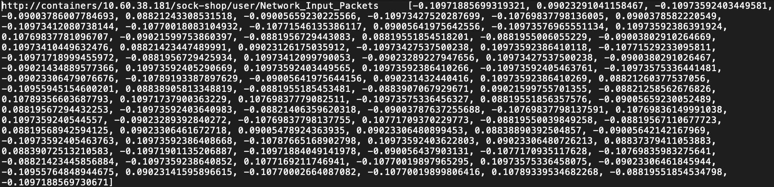
Construct
Algorithm Design
Entity -> 100D Vector
TransE

Slide 63
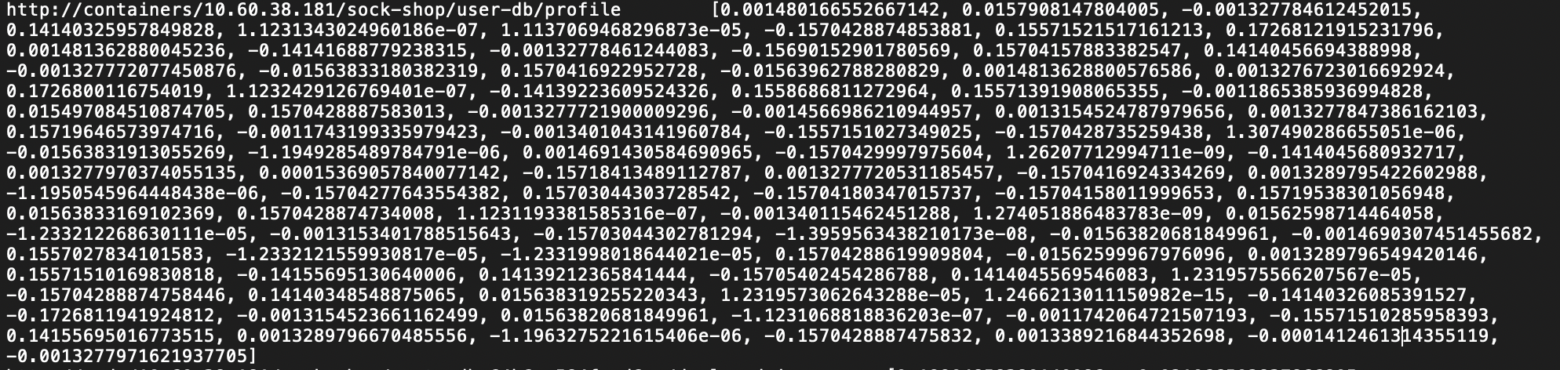
Construct
Entity -> 100D Vector
Algorithm Design
TransE
Relation -> 100D Vector

Slide 64
Construct
Algorithm Design
Fresh Relation
TransE
Fresh Entity1
Fresh Entity2

Slide 65
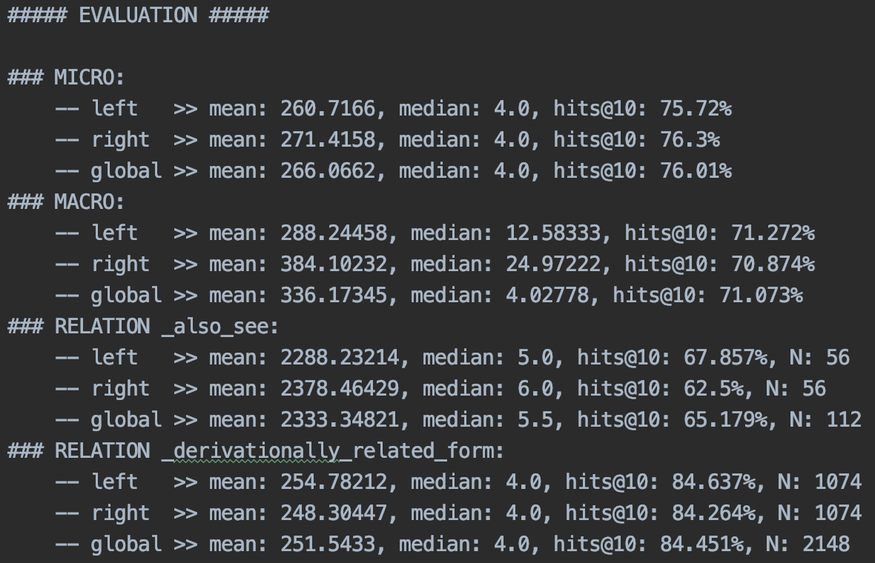
Construct
Algorithm Design
TransE

Slide 66
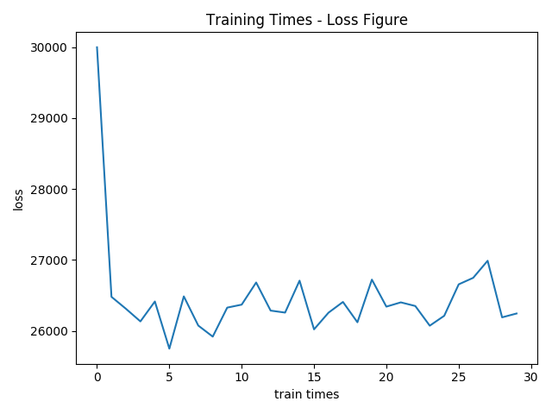
Construct
Algorithm Design
TransE

Slide 67
Knowledge
Reasoning
Thanks for listening!
doubleZ
Tongji University
All right reversed.

